Slide 1
Descriptive Statistics & Charting

Slide 2
Descriptive Statistics
Part 1

Slide 3
What is statistics?
The practice or science of collecting and analyzing numerical data in large quantities, especially for the purpose of inferring proportions in a whole from those in a representative sample.
A fact or piece of data from a study of a large quantity of numerical data.
- Oxford Dictionary -

Slide 4
Summarize, Describe, or State facts and proven outcomes from a population
Descriptive Statistics
Applied Statistics
Analyze sample to make prediction about lager population
Inferential Statistics

Slide 5
Probabilistic
Population
The entire set of items whom you wish to draw conclusions
Sample
An unbiased subset of the population that best represents (has characteristics) the whole data

Slide 6

Central Tendency (Location)
Rata-rata umur anggota tim ini berapa ya?
21
21
23
24
27

Slide 7
Mean
23.2
The addition of all numbers in the data set and then divided by the number of values in the set
Median
23
The middle value when a data set is ordered from least to greatest
Mode (Modus)
21
The number that occurs most often in a data set
21
21
23
24
27

Slide 8
Measures of Variability
Describing the shape and spread of the data set
Give aid in analyzing how dispersed the distribution is for a set of data
Min
21
The smallest value in the data set
Max
27
The largest value in the data set
21
21
23
24
27

Slide 9
Q1
21
The first quarter the data set
Q2 (Median)
23
The second quarter the data set
Q3
21
The third quarter the data set
21
21
23
24
27

Slide 10
Range (R)
6
The difference between the highest and lowest values
Interquartile Range (IQR)
3
The range of the middle half of a distribution
Standard Deviation (STD)
2.49
The average distance from the mean
21
21
23
24
27

Slide 11
Ada anggota baru yang akan masuk ke tim ini
Sekarang rata-rata umur anggota tim ini berapa ya?
21
21
23
24
27
48

Slide 12
Mean
23.2 → 27.3
Q1
21 → 21.5
Max
27 → 48
IQR
3 → 4.75
Median
21 → 23.5
Q3
24 → 26.25
Range
6 → 27
STD
2.5 → 10.37
21
21
23
24
27
48

Slide 13
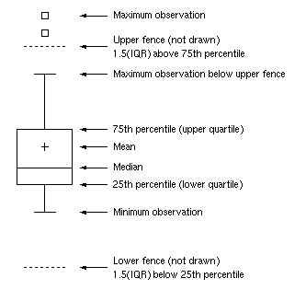
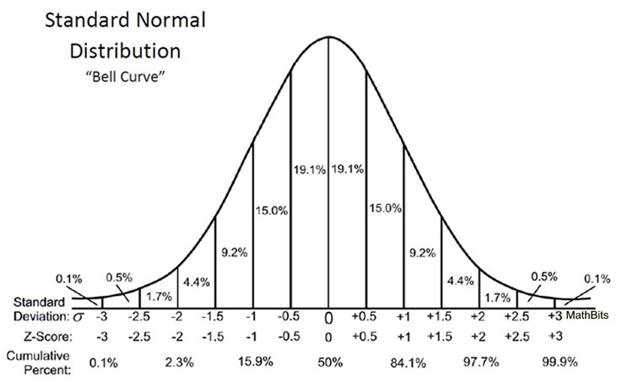
Outlier
Observation that lies an abnormal distance from other values in a random sample from a population
Box Plot

Slide 14
Charting
Part 2

Slide 15
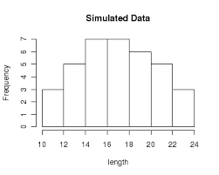
Histogram

Slide 16
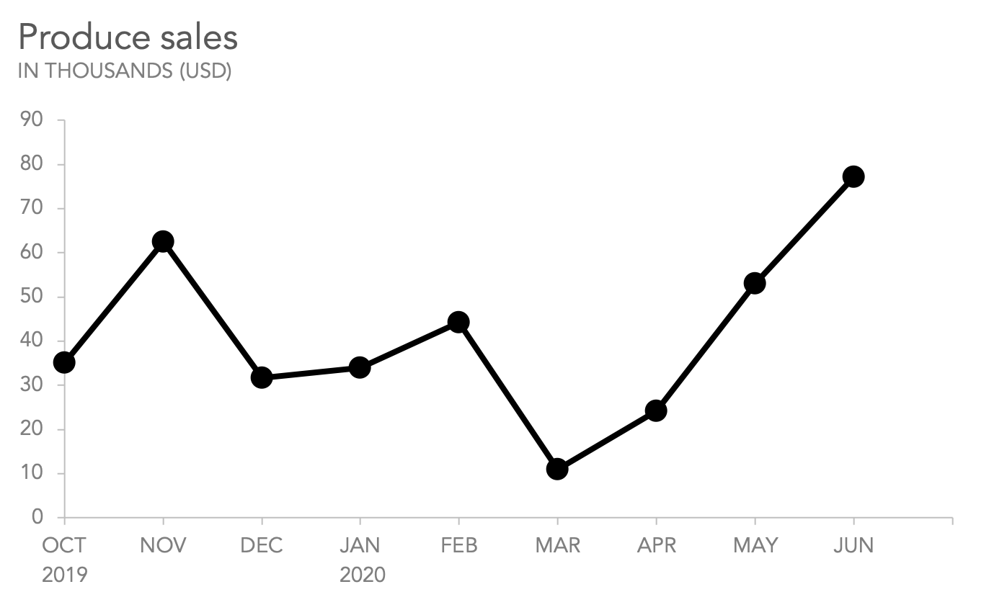
Line Chart

Slide 17
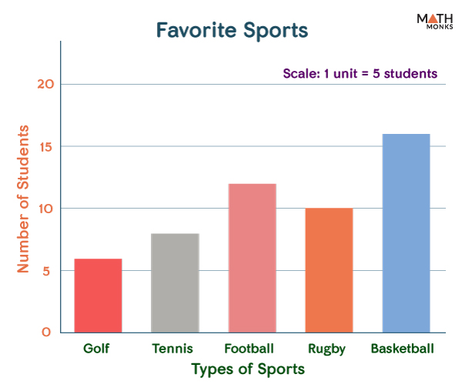
Bar Chart

Slide 18
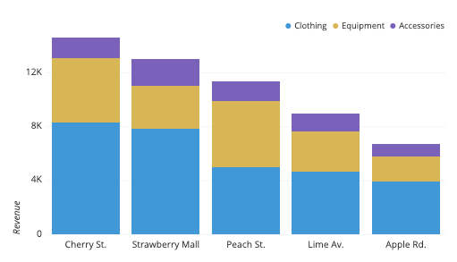
Stacked Bar Chart

Slide 19
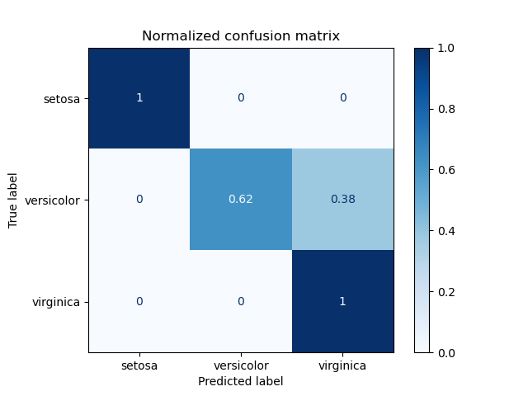
Confusion Matrix

Slide 20
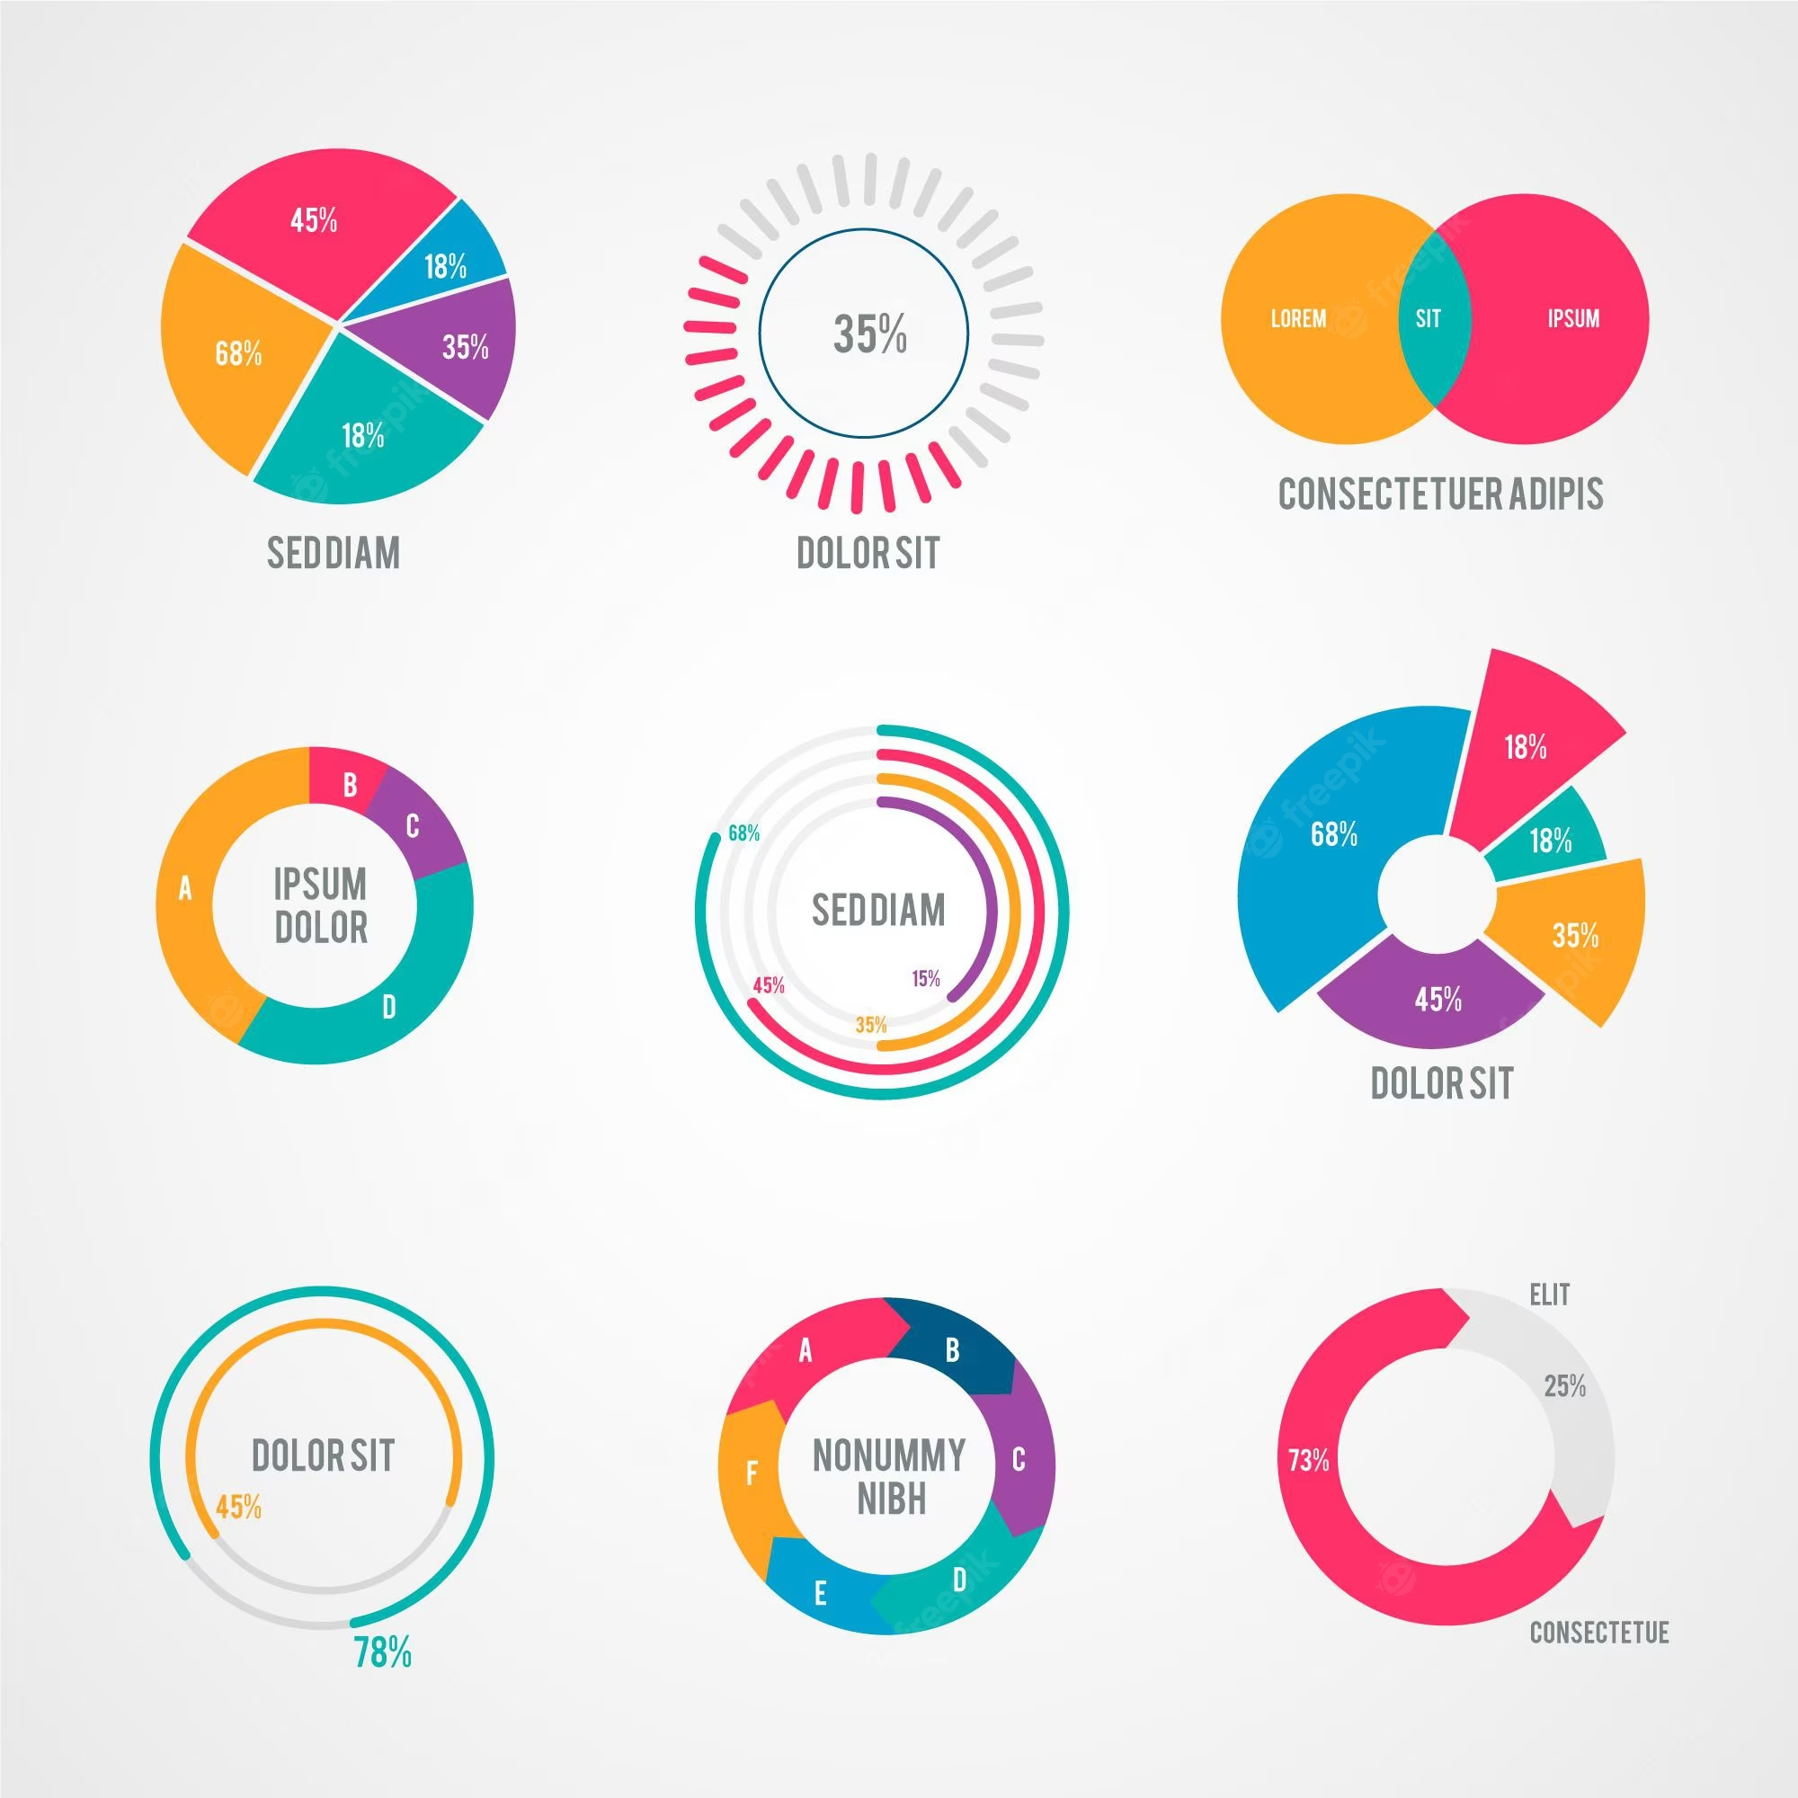
Pie Chart

Slide 21
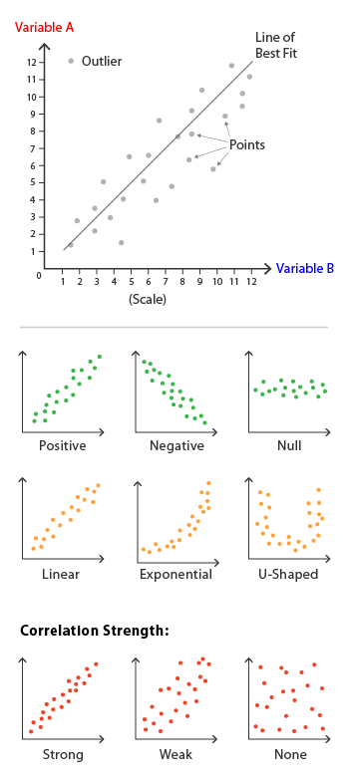
Scatter (Dot) Plot

